Slide 1
Backtracking
Sum of Subsets

Slide 2
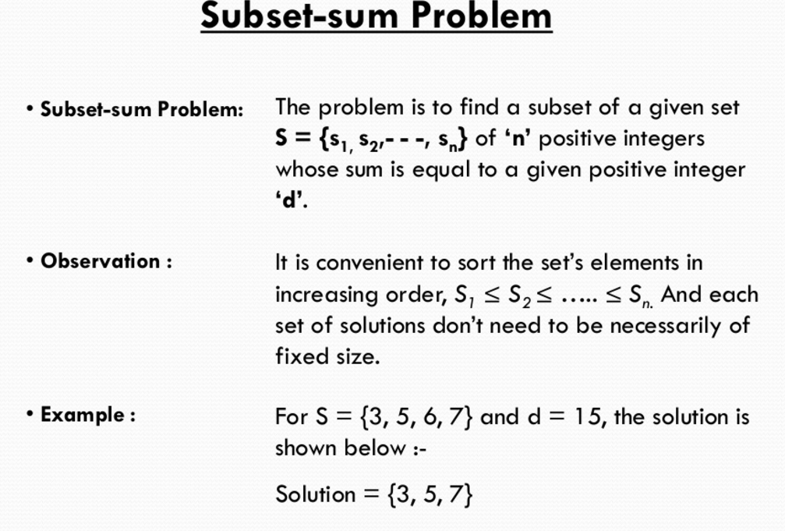
Backtracking
Implicit Constraint
No two weights should be the same
The sum of the corresponding w_{i}’s be m

Slide 3
Sum of Subsets Problem-Algorithm
Start with an empty set
Add to the subset the next element from the list
If the subset is having the sum d then stop with that subset as solution
If the subset is not feasible or we if we have reached the end of the set then backtrack through the subset until we find the most suitable value.
If the subset is feasible then repeat step 2
If we have visited all the elements without finding a suitable subset and if no backtracking is possible then stop without solution

Slide 4
Example
If n=4 (w1,w2,w3,w4)=(11,13,24,7) and m=31 then the desired subsets are (11,13,7) and (24,7)
In general all solutions are k-tuples (x1,x2,…..xk), 1<=k<=n and different solutions may have different sized tuples
Each solution subset is represented by an n-tuple(x1,x2….xn) such that xiЄ{0,1} , 1<=i<=n
The solutions to the above instance are {1,1,0,1} and {0,0,1,1}

Slide 5
0
{3,5,6,7}, d=15
X
1 | 1 | 0 | 1
1 2 3 4
3
0
3
5
0
8
14
8
9
3
11
5
15
15
8
Success

Slide 6
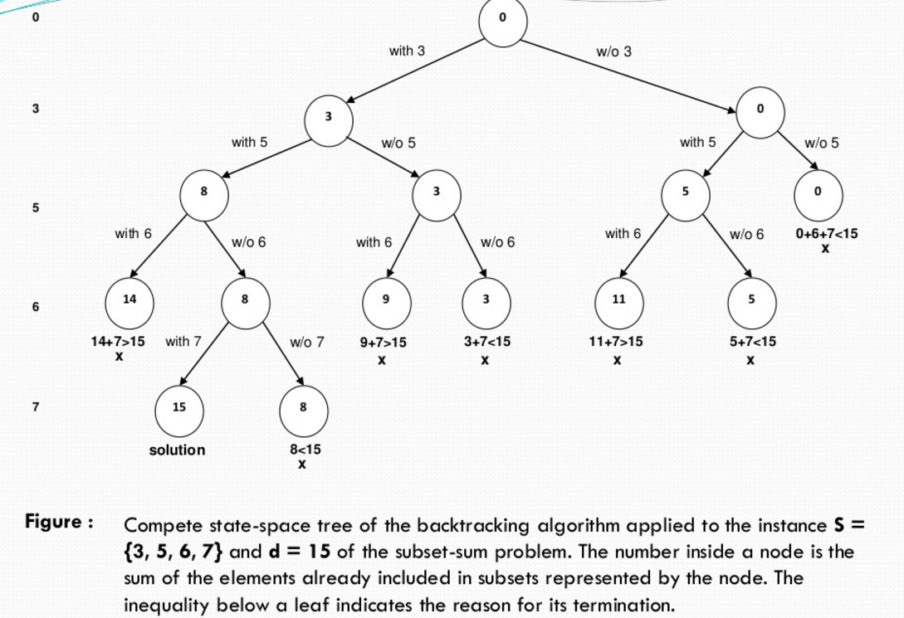

Slide 7
S={5,10,12,13,15,18}
D=30
Solve for obtaining sum of Subset.

Slide 9
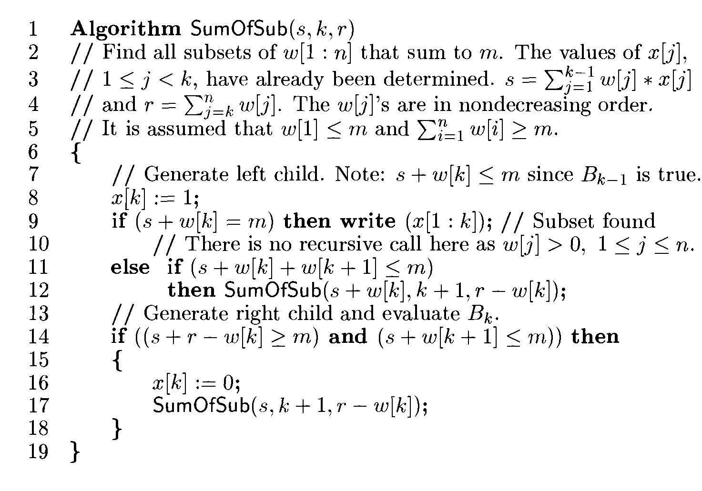
Algorithm

Slide 10
D=30
0 | 1 | 73
5 | 10 | 12 | 13 | 15 | 18
X1=1
x1
x2
x3
x4
x5
x6
5 | 2 | 68
X2=1
15 | 3 | 58
X3=0
27 | 4 | 46
15 | 4 | 46
X4=0
28 | 5 | 33
15 | 5 | 33
X5=1
30 | 6 | 18

